Slide 1
SupremeOS AI
AI-Powered Hardware ERP System

Slide 2
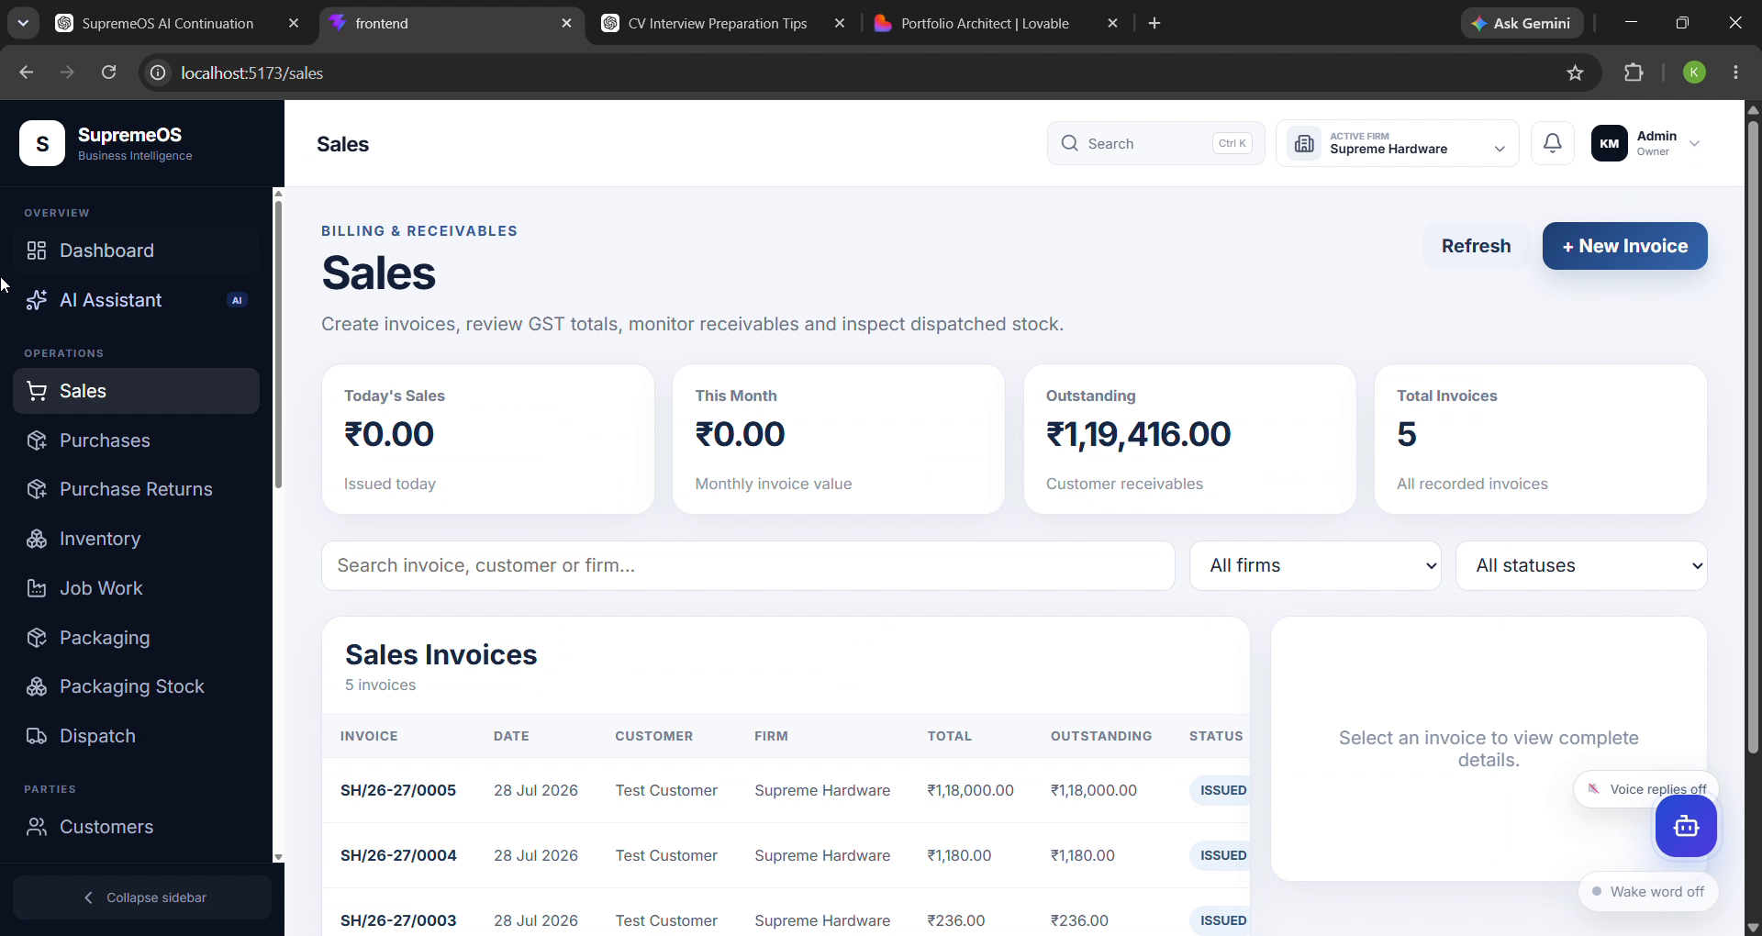
Project Overview
Modern ERP interface
Responsive dashboard
Business workflow automation
Clean UI with analytics
AI-ready architecture

Slide 3
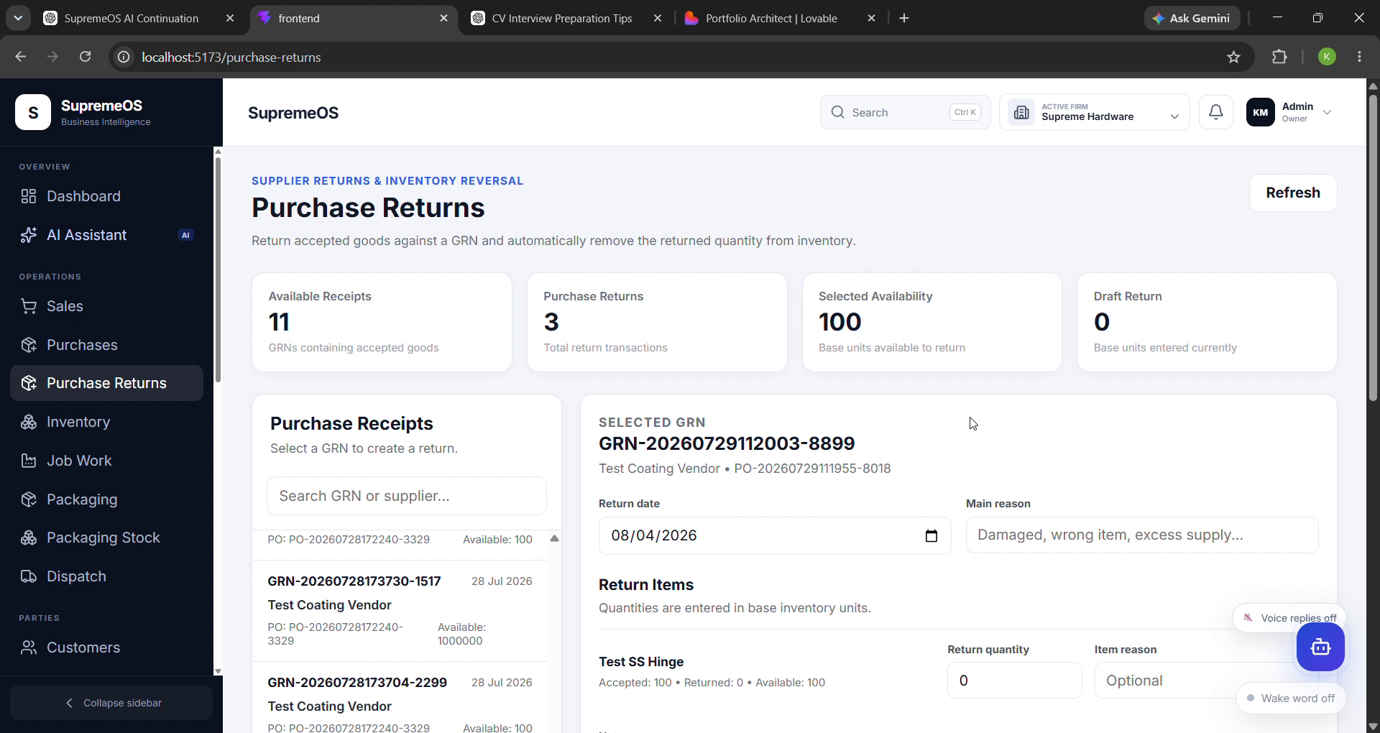
Dashboard
Modern ERP interface
Responsive dashboard
Business workflow automation
Clean UI with analytics
AI-ready architecture

Slide 4
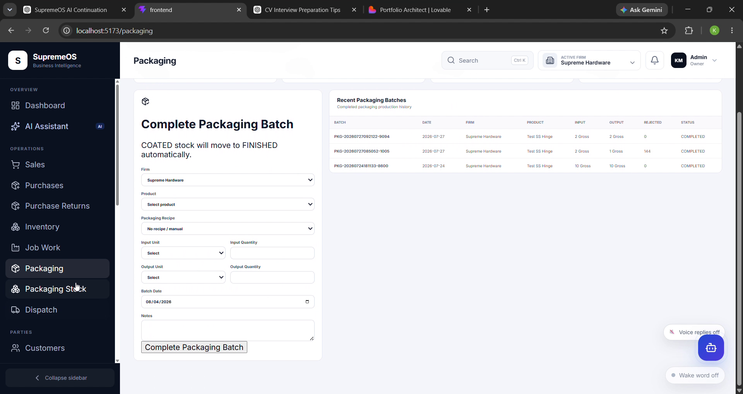
Products & Inventory
Modern ERP interface
Responsive dashboard
Business workflow automation
Clean UI with analytics
AI-ready architecture

Slide 5
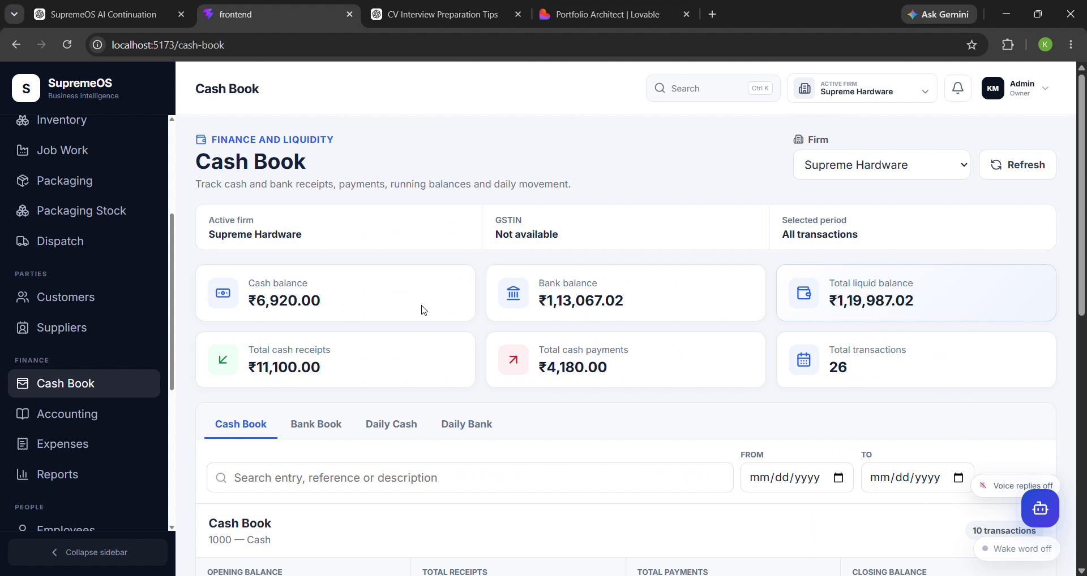
Purchases
Modern ERP interface
Responsive dashboard
Business workflow automation
Clean UI with analytics
AI-ready architecture

Slide 6
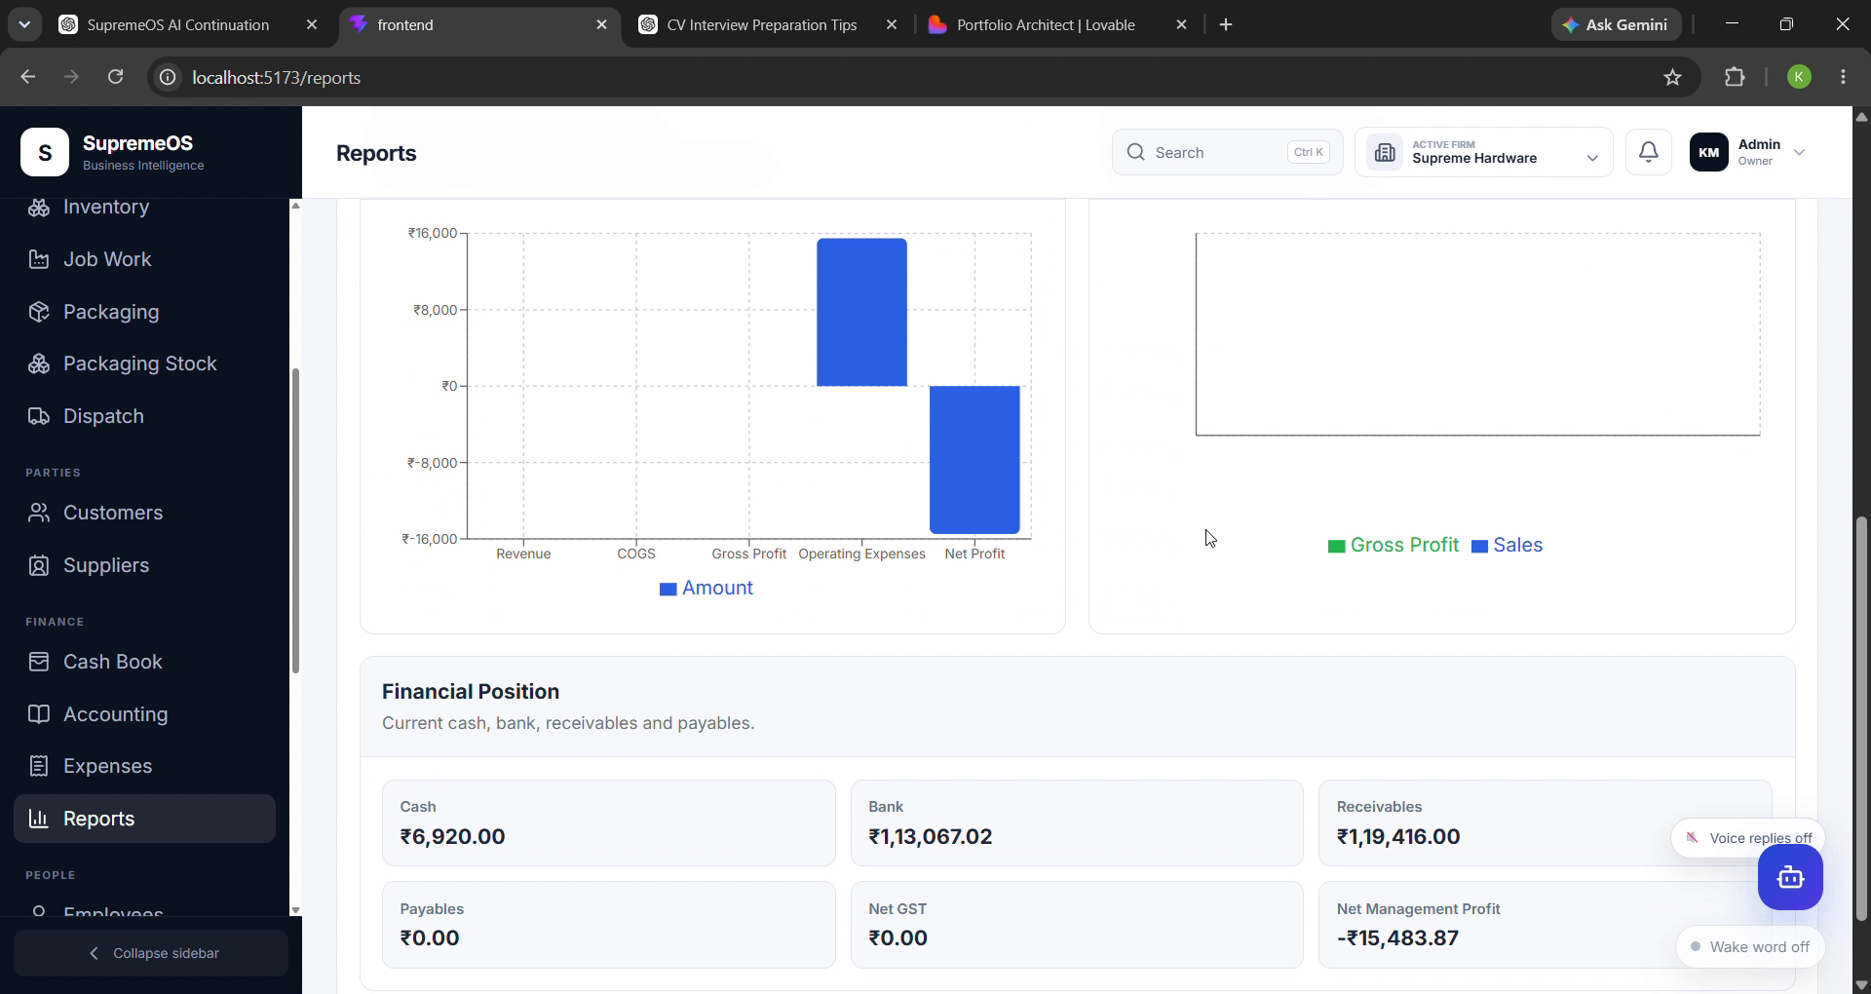
Sales & Reports
Modern ERP interface
Responsive dashboard
Business workflow automation
Clean UI with analytics
AI-ready architecture

Slide 7
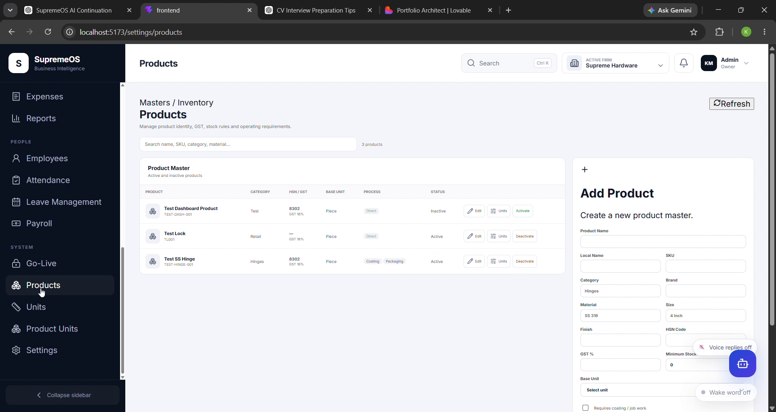
AI Assistant
Modern ERP interface
Responsive dashboard
Business workflow automation
Clean UI with analytics
AI-ready architecture

Slide 8
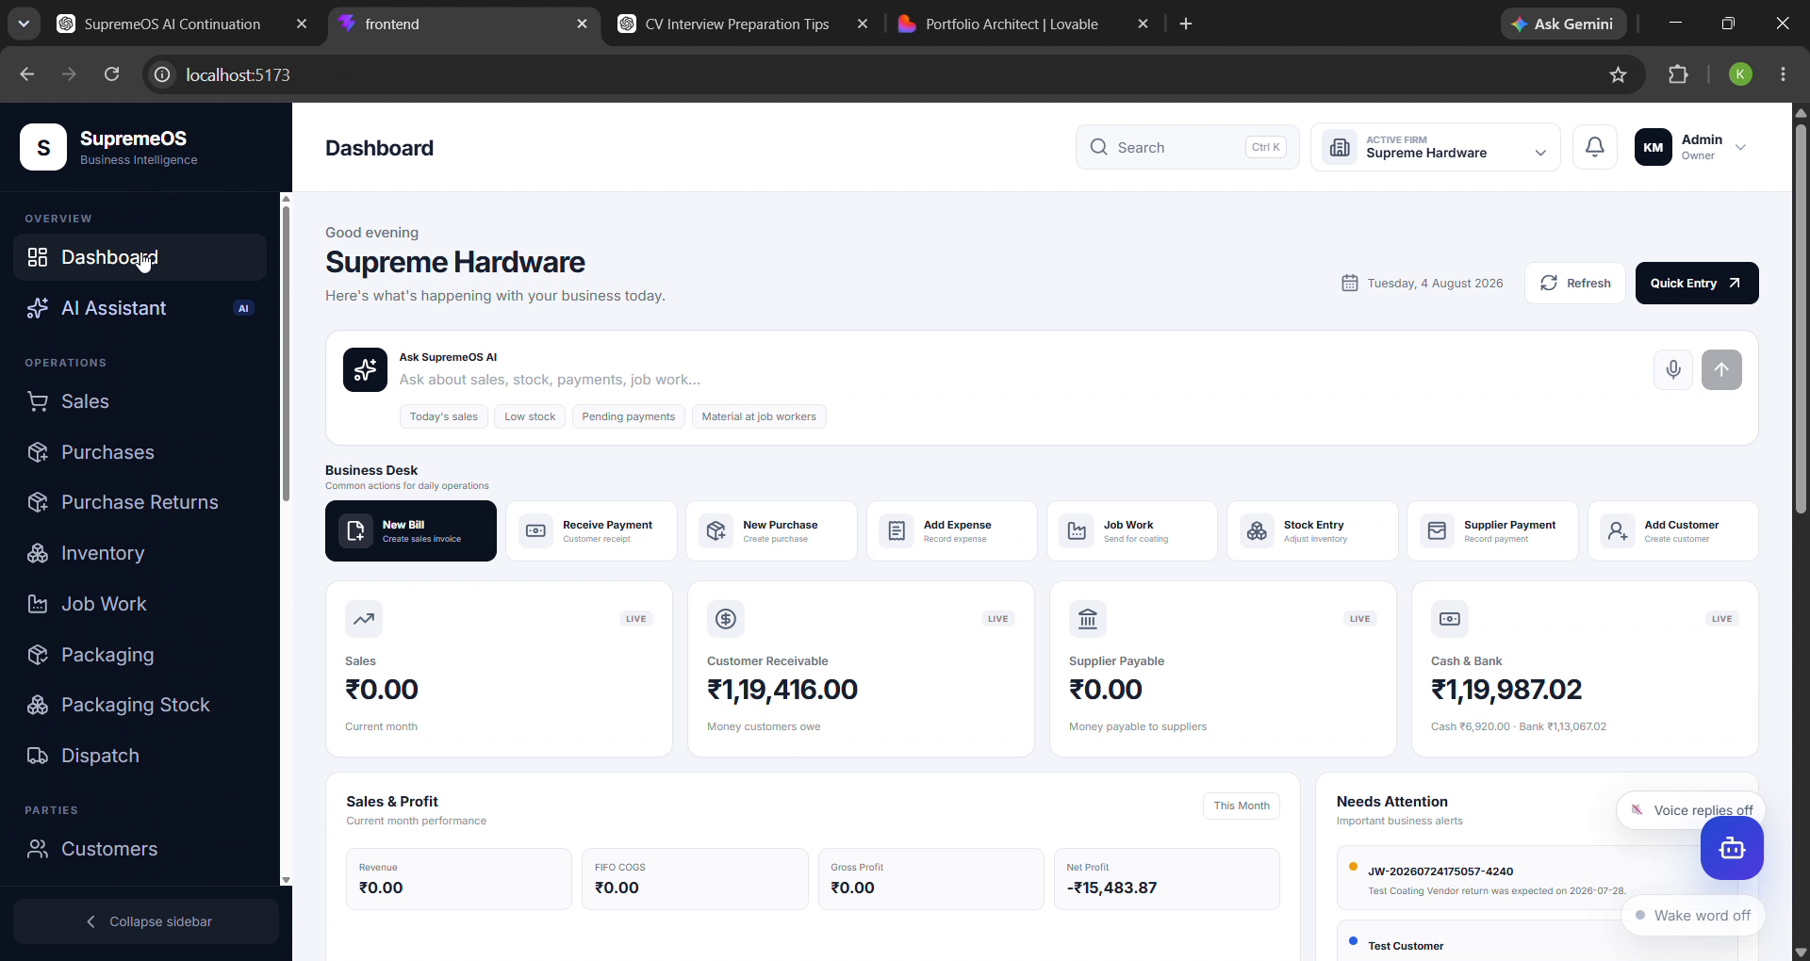
Conclusion
Modern ERP interface
Responsive dashboard
Business workflow automation
Clean UI with analytics
AI-ready architecture

